Slide 1
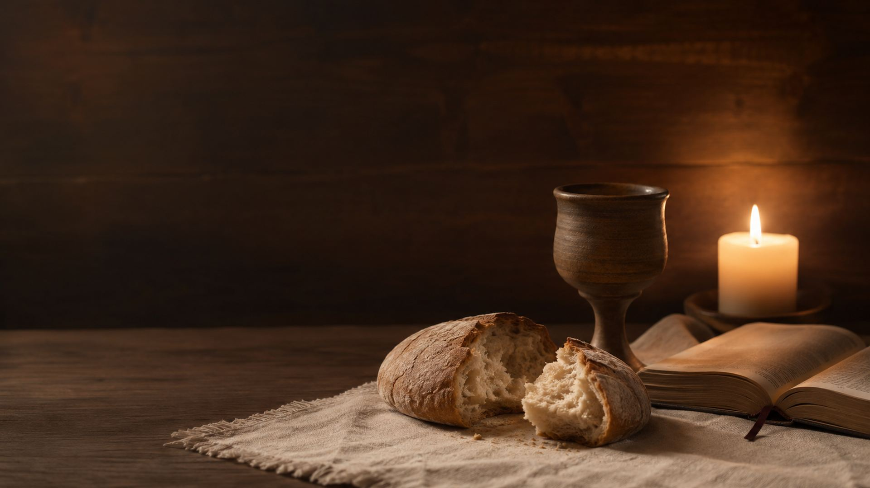
Hymn Study Teaching Guide
Be Known to Us in Breaking Bread
First line: “Be known to us in breaking bread”
Author: James Montgomery
Tune: ST. FLAVIAN • Meter: Common Meter
First published: The Christian Psalmist, 1825
Primary Scripture: Luke 24:30–35
Prepared for teaching and small group use - hymninfo.com

Slide 2

Teaching Aim
Understand the hymn as a communion prayer rooted in the Emmaus story.
Feel renewed wonder that the risen Christ is known by His people in word, fellowship, prayer, and table.
Practice reverent expectation, shared fellowship, and grateful witness around the Lord’s Table.
Prepared for teaching and small group use - hymninfo.com

Slide 3
Hymn Identity
Text and Setting
Musical Identity
Title: “Be Known to Us in Breaking Bread”
First line: “Be known to us in breaking bread”
Author: James Montgomery
First published in The Christian Psalmist in 1825 under “The Family Table”
Meter: Common Meter, 8.6.8.6
Frequently sung to ST. FLAVIAN
ST. FLAVIAN comes from the early English psalter tradition
The hymn may also be sung to other Common Meter tunes
Prepared for teaching and small group use - hymninfo.com

Slide 4

HISTORICAL BACKGROUND
A Table Hymn from James Montgomery
A brief communion text with warm biblical and pastoral depth.
Prepared for teaching and small group use - hymninfo.com

Slide 5
Historical Background
James Montgomery was a poet, editor, hymn writer, and public advocate shaped in part by a Moravian background.
He published this hymn in 1825 in The Christian Psalmist, a collection intended for public, private, and social devotion.
The heading “The Family Table” helps explain the hymn’s intimate tone: it is a prayer for fellowship with Christ at the table.
Its simplicity has helped it serve as a quiet communion hymn across many English-language Protestant traditions.
Prepared for teaching and small group use - hymninfo.com

Slide 6
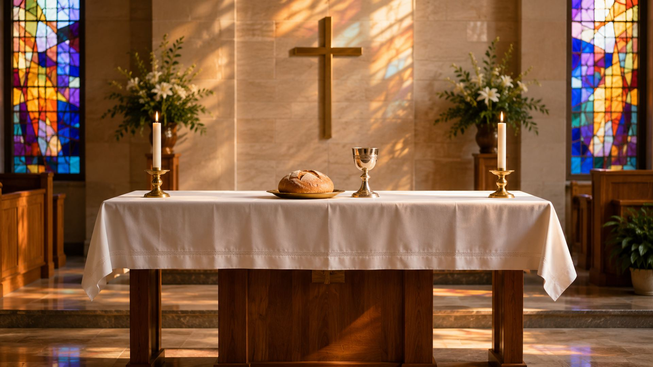
Why This Hymn Matters Today
It helps the church approach communion as prayerful encounter with the risen Lord.
It connects the Lord’s Table with Scripture, fellowship, and worship rather than treating it as an isolated act.
It gives congregations language for reverence, expectation, and gratitude.
It reminds worshipers that Christ is known not only in memory but in living fellowship by faith.
Prepared for teaching and small group use - hymninfo.com

Slide 7

BIBLICAL FOUNDATION
Recognized in the Breaking of Bread
The road to Emmaus gives the hymn its central image and prayer.
Prepared for teaching and small group use - hymninfo.com

Slide 8
Primary Scripture
“
Their eyes were opened, and they recognized him; then he vanished out of their sight.
Luke 24:31
Prepared for teaching and small group use - hymninfo.com

Slide 9
Supporting Scriptures
Luke 24:32–35 shows that recognition leads to burning hearts, gathered fellowship, and witness.
Acts 2:42 places the breaking of bread alongside the apostles’ teaching, fellowship, and prayer.
1 Corinthians 10:16 speaks of the bread and cup as a sharing in Christ.
1 Corinthians 11:26 teaches that the meal proclaims the Lord’s death until He comes.
John 6:35 identifies Jesus as the bread of life.
Prepared for teaching and small group use - hymninfo.com

Slide 10

HYMN STUDY
A Prayer at the Table
The hymn moves from recognition to abiding communion and lasting nourishment.
Prepared for teaching and small group use - hymninfo.com

Slide 11
Opening Prayer: Recognize the Risen Lord
The first petition asks Christ to be known in the breaking of bread.
This directly echoes the Emmaus disciples, whose eyes were opened at the table.
Teaching emphasis: communion is not bare routine; faith seeks and receives the living Christ.
Scripture connection: Luke 24:30–31.
Prepared for teaching and small group use - hymninfo.com

Slide 12
Abiding Presence: Do Not Depart
The hymn asks the Savior to remain with His people after the moment of recognition.
This prayer echoes the longing of disciples who discover that the crucified Jesus is risen and present.
Teaching emphasis: Christian worship is sustained by Christ’s abiding mercy, not by human feeling alone.
Scripture connection: Luke 24:32–35.
Prepared for teaching and small group use - hymninfo.com

Slide 13
The Table in the Heart
The hymn moves from the outward table to inward communion with Christ.
Its language invites the congregation to receive the meal with faith, repentance, love, and gratitude.
Teaching emphasis: the Lord’s Supper nourishes the whole life of discipleship.
Scripture connection: Acts 2:42 and John 6:35.
Prepared for teaching and small group use - hymninfo.com

Slide 14
Living Bread and Heavenly Wine
The final movement reflects on bread and cup as signs of divine love and spiritual nourishment.
The hymn is brief, but it points to rich communion with Christ and fellowship in His body.
Teaching emphasis: the Lord’s Table proclaims Christ’s death, feeds faith, and strengthens hope.
Scripture connection: 1 Corinthians 10:16 and 11:26.
Prepared for teaching and small group use - hymninfo.com

Slide 15
Theological Themes
What the Hymn Teaches
How the Church Responds
Resurrection presence of Christ
Recognition by faith
Communion as fellowship with the Lord
Spiritual nourishment through bread and cup
Reverent expectation at the table
Unity in the body of Christ
Grateful remembrance of the cross
Witness that the Lord is risen indeed
Prepared for teaching and small group use - hymninfo.com

Slide 16
Literary Observations
The hymn is compact and prayer-shaped rather than argumentative.
Its central image comes from a biblical action: taking, blessing, breaking, and giving bread.
It moves from table recognition to inward fellowship and spiritual food.
The gentle language makes it especially suited to reflective communion use.
Prepared for teaching and small group use - hymninfo.com

Slide 17
Musical Observations
ST. FLAVIAN
Congregational Use
Common Meter: 8.6.8.6
Balanced phrases and modest range
Quiet dignity suitable for communion
Works best at a calm, unhurried tempo
Short enough for distribution or response
Easy to pair with Luke 24 readings
Can be sung gently by choir or congregation
Accompaniment should support prayerful clarity
Prepared for teaching and small group use - hymninfo.com

Slide 18
Pastoral and Worship Use
Communion services and Lord’s Supper responses
Eastertide worship centered on the risen Christ
Teaching on Luke 24 and the Emmaus road
Services focused on fellowship, hospitality, and the gathered church
Choir or congregational meditation before or after receiving communion
Prepared for teaching and small group use - hymninfo.com

Slide 19
Teaching Questions
Why is Christ recognized in the breaking of bread in Luke 24?
How do Scripture, prayer, fellowship, and table belong together in Acts 2:42?
What does it mean to ask Christ to spread His table in the heart?
How should the Lord’s Table deepen unity, repentance, and gratitude?
What witness should flow from recognizing the risen Lord?
Prepared for teaching and small group use - hymninfo.com

Slide 20
Application
Come to communion seeking Christ Himself, not merely a familiar custom.
Prepare through Scripture, prayer, repentance, and reconciliation.
Receive the bread and cup with gratitude for the crucified and risen Lord.
Let the Lord’s Table send you toward fellowship, hospitality, and witness.
Pray for Christ to be known not only at church, but in the heart and home.
Prepared for teaching and small group use - hymninfo.com

Slide 21
Suggested Lesson Flow
30-Minute Plan
60-Minute Plan
Read Luke 24:30–35 aloud
Introduce Montgomery and the hymn’s communion setting
Discuss the opening prayer and Emmaus image
Close with one application question and prayer
Read Luke 24:13–35 and Acts 2:42
Trace the hymn’s movement section by section
Discuss theological themes and worship use
Plan a communion response or group prayer practice
Prepared for teaching and small group use - hymninfo.com

Slide 22
CLOSING PRAYER
Known at the Table, Sent in Hope
Risen Lord, open our eyes, warm our hearts, and abide with Your people.
Prepared for teaching and small group use - hymninfo.com

Slide 23
Closing Summary and Prayer
This hymn is a brief but rich prayer for the risen Christ to be recognized and received at the table.
It joins Emmaus, communion, fellowship, and spiritual nourishment.
Prayer: Risen Lord Jesus, make Yourself known to us in Your word, in fellowship, and at Your table. Abide with us, nourish our faith, and send us with joy. Amen.
Prepared for teaching and small group use - hymninfo.com

Slide 24
Usage Notice
© HymnInfo.com. Free for personal, church, classroom, and small-group teaching use. Please do not sell, repost, or redistribute as downloadable files without permission.
hymninfo.com
Prepared for teaching and small group use - hymninfo.com

